Slide 1
Electric Vehicle Adoption Trends and
Consumer Sentiment Analysis
Group 24 Team Members
Tejamanikanta Gudla - 11647757
Pavan Kalyan Naini - 11654829
Chintureddy Baireddy - 11642169
Spandana Manbol - 11659879

Slide 2
Agenda
Introduction
Literature Survey
Abstract(Problem statement)
Objectives of the Study
Defining Hypothesis
Research Design(Blueprint/Workflow)
Dataset Description
Data Pre-Processing
EDA
Model Description
Practical Applications of this Study
Conclusion
References

Slide 3
Introduction
The project combines the art of machine learning and data analytics to study EV adoption and consumer attitudes. Uses Python tools for data analysis, visualization, and predictive modeling.
Predictive models include:
Bass Diffusion Model
Generalized Bass Model (GBM)
Customer sentiment analysis involves:
Conventional approaches: Gradient Boosting, Logistic Regression, Random Forest for structured text analysis and deep learning models like LSTM for analyzing textual data in sequence.
Enables accurate sentiment classification, providing insights into consumer attitudes towards the EV market

Slide 4
Literature Survey
We have referred to 64 around papers in this project, focusing on topics such as:
Electric vehicle adoption trends.
Consumer sentiment analysis methodologies.
Predictive modeling techniques, including Bass Diffusion Model and Generalized Bass Model.
Machine learning algorithms for sentiment classification.
Base Paper: This paper constructs a generalized Bass diffusion model that accounts for the "green premium"—the cost difference between emission-emitting and zero-emission technologies. Using time series data from the Chinese market, the model predicts EV market penetration over the next decade, highlighting the significant role of green premiums in EV adoption.

Slide 5
Problem Statement
The transportation sector is undergoing a significant shift towards electric vehicles (EVs) due to sustainability and innovation demands.
Market Trends and Consumer Attitudes: Limited understanding of factors driving EV adoption and consumer concerns.
Challenges:
Accurately predicting the adoption rates of EVs.
Addressing consumer concerns regarding environmental impact, battery capacity, and charging systems.
Need for Insights: A dual approach combining data-driven predictions and consumer sentiment analysis is essential for guiding stakeholders in the evolving EV market.

Slide 6
Objective
Quantitative Analysis: To apply and compare various diffusion models to forecast EV sales, accounting for external factors like government policies and market trends.
Qualitative Analysis: To evaluate consumer sentiment using sentiment analysis tools to extract and analyze opinions from online reviews
To identify key factors influencing consumer purchase decisions and satisfaction.

Slide 7
Defining Hypothesis
1. Forecasting Hypothesis
The forecasting component uses the Bass Diffusion Model to predict EV adoption trends. The model parameters—innovation rate (p), imitation rate (q), and market potential(m)—are central to understanding the dynamics of market adoption. The objective of these hypotheses is to validate the statistical significance of each parameter and determine their contributions to the model's predictive power.

Slide 8
Defining Hypothesis
1. Sentiment Analysis Hypothesis :
The sentiment analysis component evaluates the performance of various models—traditional machine learning models (e.g., Logistic Regression, Gradient Boosting, Random Forest) and a deep learning model (LSTM)—in classifying consumer sentiments from textual data. The aim of these hypotheses is to determine whether advanced deep learning models offer a significant performance advantage over traditional models in understanding consumer sentiment.

Slide 9
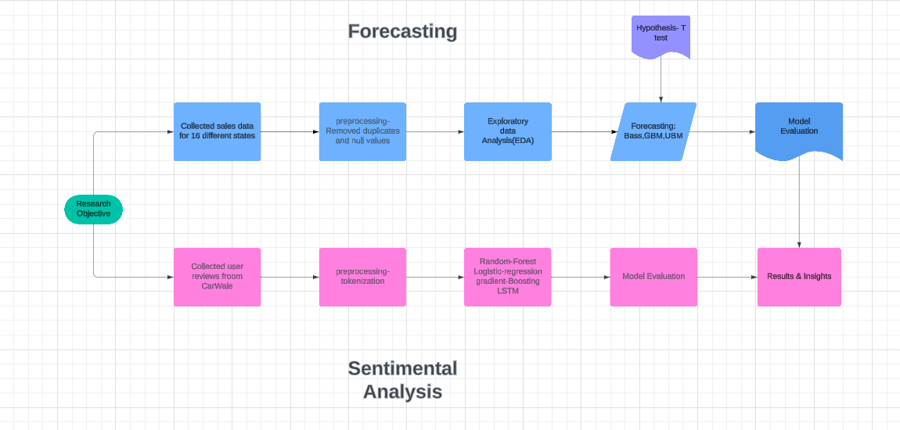
Research Design & Flowchart

Slide 10
Individual Contribution
Teja specializes in research and literature review, gathers information for the project, analyses consumer reviews sentiment, and assesses the effectiveness of the applied AI algorithms.
Pavan writes research and literature structure, collects datasets, uses machine learning models for predicting the EV adoption, and engages in assessing the efficacy of the models.
Spandana involved in research and literature structure, data preparation and cleaning, and documentation of all processes, methodologies, and findings are well handled.
Chintureddy is responsible for the working on the research and literature structure, exploration of the data through EDA, building of the hypothesis to be tested in the project, and documentation of the work.

Slide 11
Data Description
EV Sales Dataset
Source: https://www.atlasevhub.com/materials/state-ev-registration-data/
The dataset includes EV registration records from 16 U.S. states.
Fields cover registration years, vehicle models, and total registration counts.
Data was extracted and processed using Excel:
Cleaning: Removed null values, standardized state and vehicle names.
The existing dataset contains 8.2k records without duplicates.
Pivoting: Rearranged the data to facilitate time-series analysis, ensuring no missing values or redundant entries.
The processed data was used for applying the Bass Diffusion Model and generating adoption trends over time.

Slide 12
Data Description
Consumer Reviews Dataset
Source: https://www.kaggle.com/datasets/deadprstkrish/ev-cars-user-reviews-india
The dataset contains user reviews of electric vehicles.
Fields include user-provided textual reviews, vehicle models, ratings, and other related metadata.
Text data was preprocessed to remove special characters, URLs, and unnecessary white spaces.
Tokenization is applied to prepare the text for sentiment analysis.
The cleaned data was then vectorized using methods like TF-IDF for traditional models and word embeddings for advanced models.

Slide 13
Data pre-processing
For EV Sales Data:
Data Cleaning:
Removed null values and standardized the format of state names and vehicle models.
Filtered the dataset to include only relevant data from 16 U.S. states.
Data Transformation:
Pivoted the data into a time-series format to facilitate trend analysis and model inputs.
Adjusted numerical fields for consistency and removed duplicates.

Slide 14
Data pre-processing
Consumer Reviews:
Text Cleaning:
Removed special characters, numbers, URLs, and HTML tags from the reviews.
Converted all text to lowercase to standardize formatting.
Feature Engineering:
Tokenized reviews into individual words.
Extracted numerical features like word counts and sentiment scores for analysis.
Classifying ratings to [positive, neutral and negative] from numerical.

Slide 15
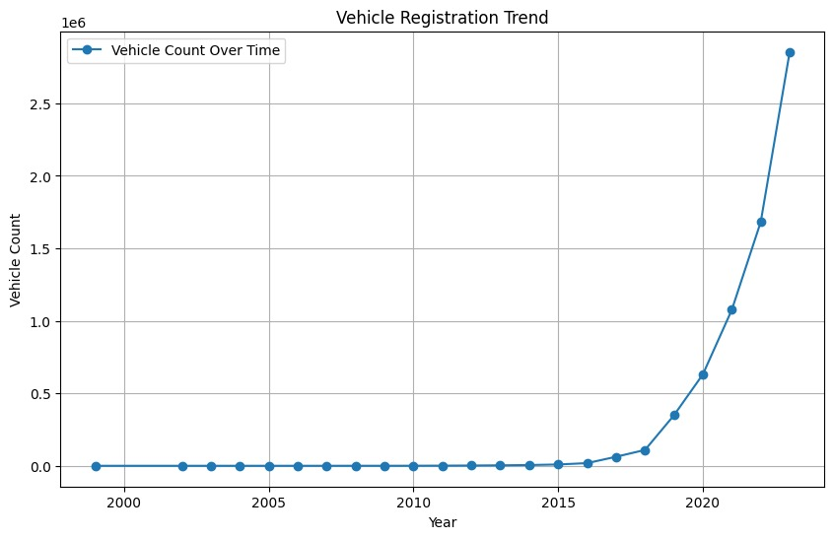
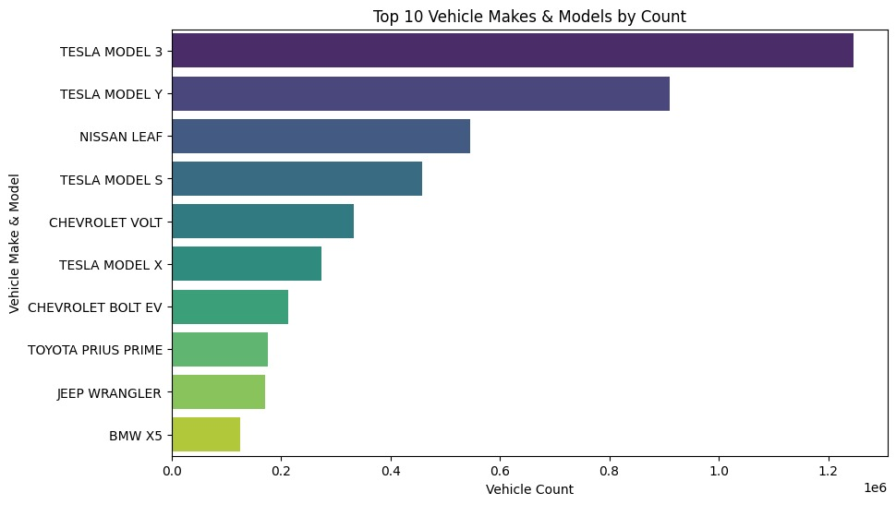
Exploratory Data Analysis (EDA)
The EV market experienced a slow start but saw exponential growth in recent years.
This chart underscores consumer preferences and market leaders in the EV industry, showing the dominance of specific brands like Tesla and the growing competition from others.

Slide 16
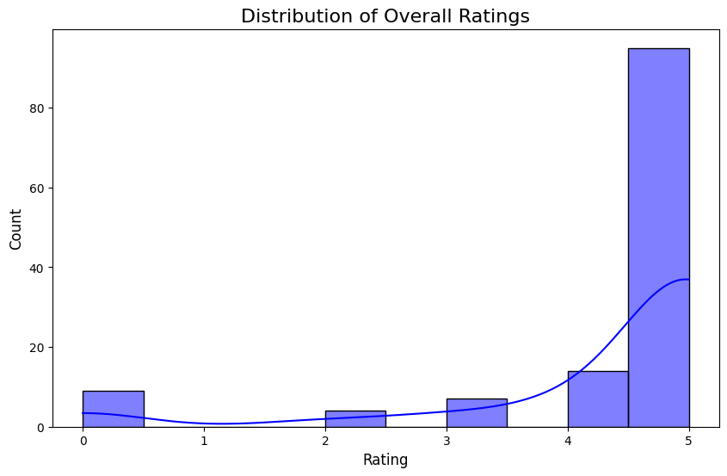
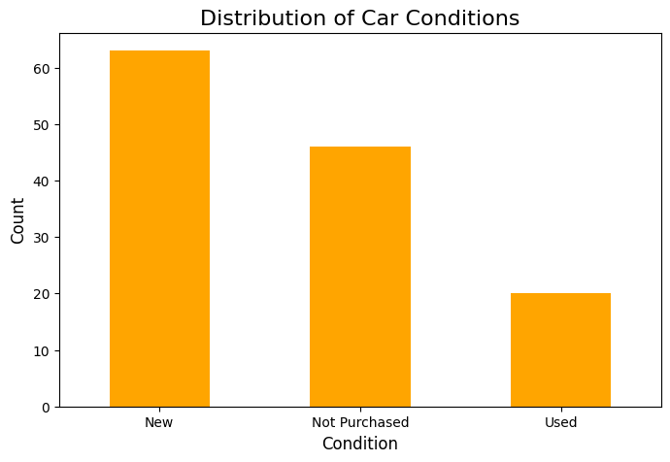
Exploratory Data Analysis (EDA)
This histogram visualization titled "Distribution of Overall Ratings" provides insights into the distribution of ratings in the dataset.
This bar chart titled “Distribution of Car Conditions” represent the frequency of car conditions in dataset.

Slide 17
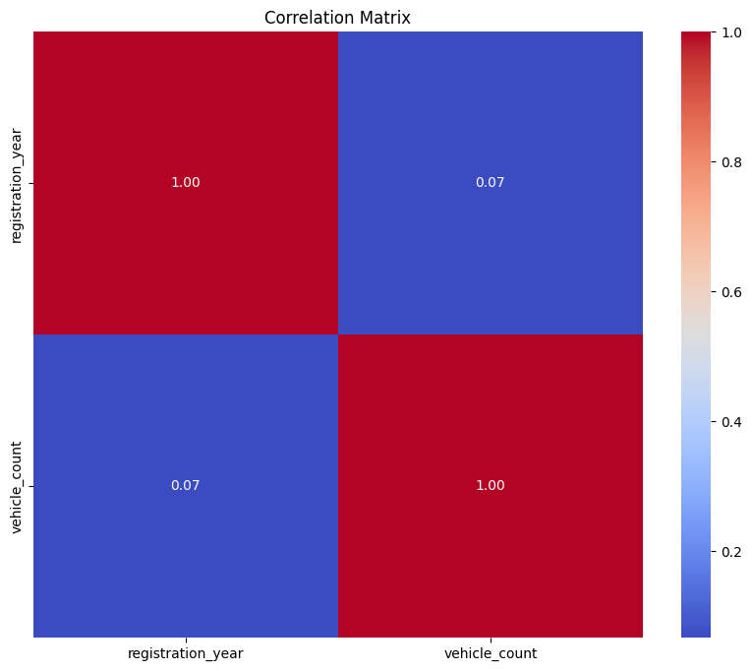
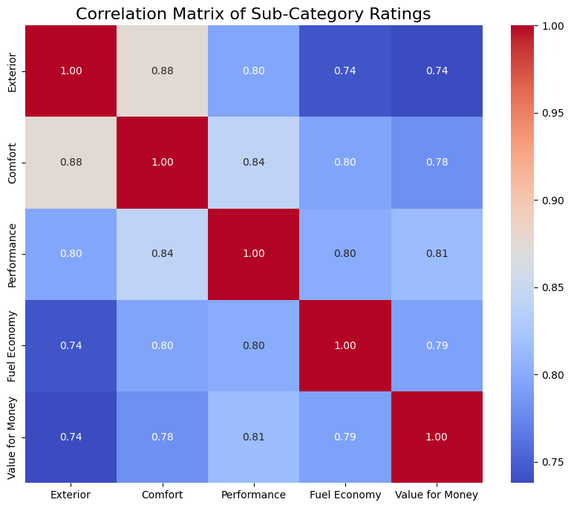
Data Analysis and Model Building
Correlation Matrix for Sales Forecasting
Correlation matrix for Sub-Categories of Sentimental analysis
This matrix evaluates the correlation between registration_year and vehicle_count.
This matrix shows the correlation between different sub-categories of ratings: Exterior, Comfort, Performance, Fuel Economy, and Value for Money.

Slide 18
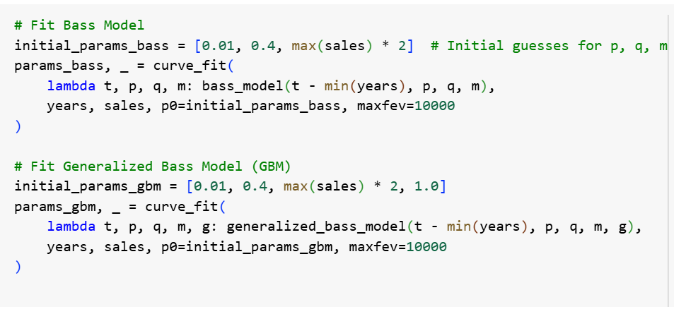
Model Building for Forecasting
Grouped sales data by year and calculated yearly vehicle counts.
Selected diffusion models (Bass Model and Generalized Bass Model) to forecast EV adoption
Fitted the models to historical sales data using curve_fit for parameter optimization.
Simulated future sales (e.g., 5 years) using the fitted models and included uncertainty estimates.

Slide 19
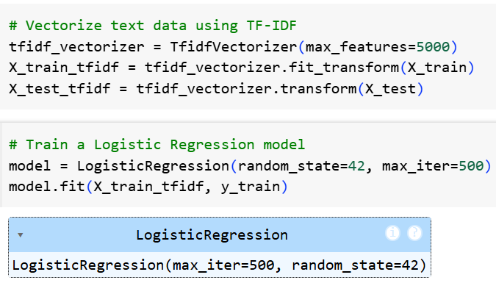
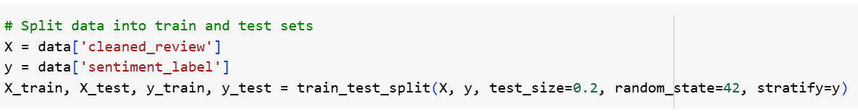
Model Building for Sentiment Analysis
Text Preprocessing:
Cleaned reviews by removing punctuation, numbers, stopwords, and converting text to lowercase.
Transformed text into numerical features using TF-IDF Vectorization.
Model Development:
Split data into training and testing sets for robust evaluation.
Trained classifiers like Logistic Regression using training data.

Slide 20
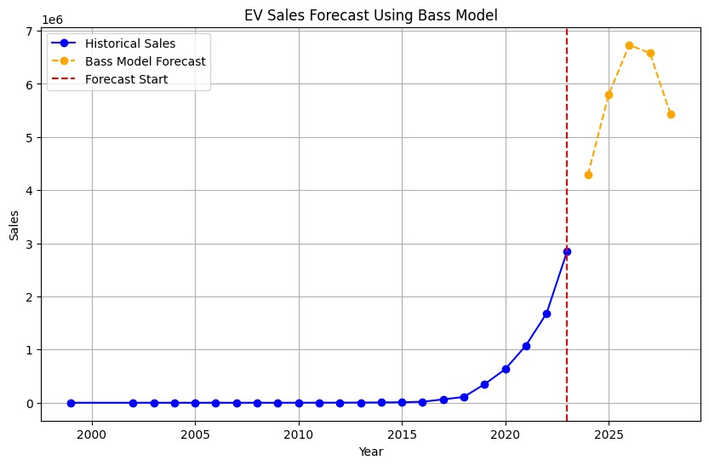
Bass Diffusion Model Forecasting
Exhibits a trend that is sharply raised from the beginning and joins the curve of steady and gradual rise of the second segment.
Predicts a steady increase in EV sales over time, closely aligned with historical data up to the forecast start year.
The model is quite appropriate for measuring incremental or organic market growth brought about by innovation and imitation but has no facility to handle uncertainty or external factors.

Slide 21
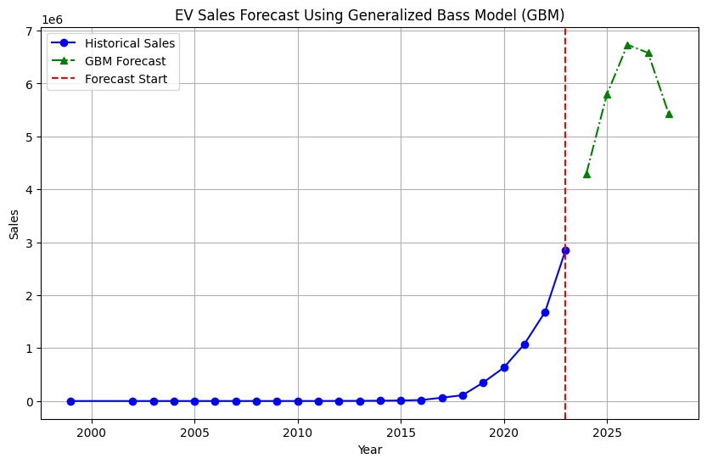
Generalized Bass Model Forecasting
Expands the basic Bass model with a better forecast’s capability than the original.
This means that according to his model Little warned of a rapid growth in sales in the period after starting the forecast and followed by a decline.
Indicates that the market may saturate quickly after an initial spike, suggesting a finite adoption limit or external constraints (e.g., infrastructure, policy).

Slide 22
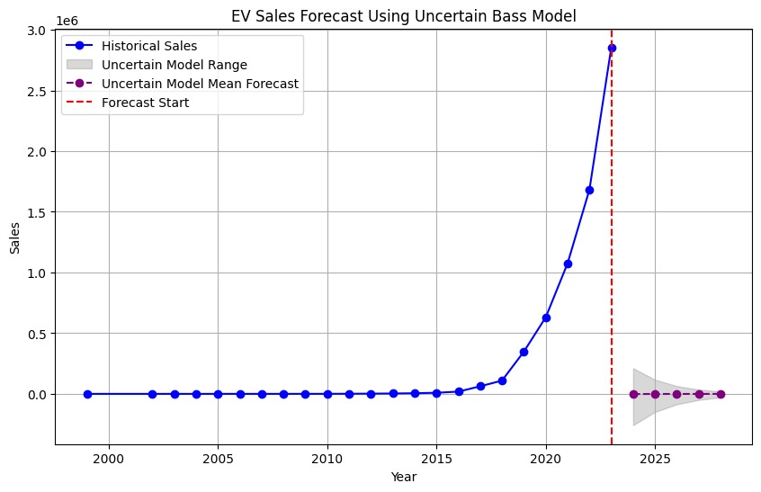
Uncertain Bass Model Forecasting
A variety of potential results, as expressed through the term uncertainty bounds.
Less optimistic mean estimate compared to the GBM but includes variability, which is beneficial for decision making under uncertainty.
Emphasizes external conditions where the original models don’t provide enough information about market shocks or policy changes.

Slide 23
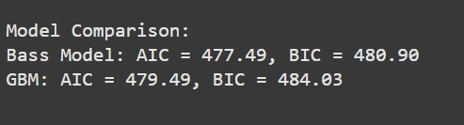
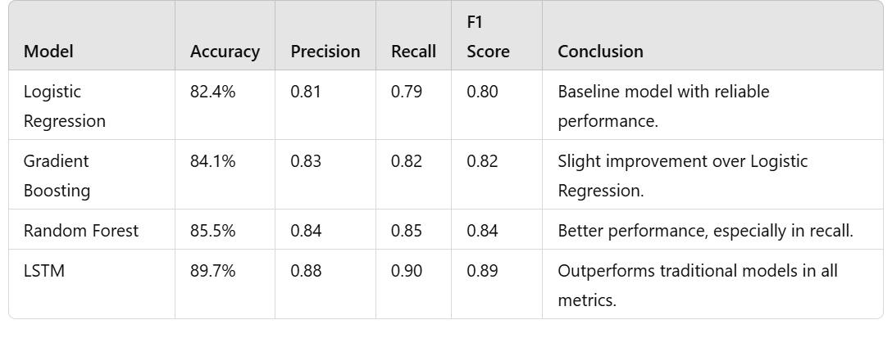
Model Evaluation
Sales Forecasting
Compared models using metrics like AIC, and BIC to evaluate fit.
Visualized historical vs. predicted sales to assess forecast accuracy.
Sentiment Analysis
Machine Learning Models: Evaluated using accuracy, confusion matrix, and classification report (e.g., Logistic Regression, Random Forest).
Evaluated model performance using metrics such as Accuracy, Precision, Recall, and F1-Score.

Slide 24
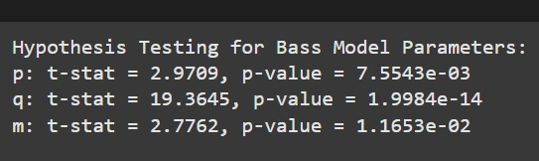
Hypothesis Testing for Forecasting
Null hypothesis:
The bass model parameters P, Q, and M do not significantly contribute to the model(P=0,Q=0,M=0)
Alternative Hypothesis:
At least one of the bass model parameters P, Q, or M significantly contributes to the model(P!=0,Q!=0,M!=0)
Conclusion:
Since the p-values for all three parameters(P, Q, and M) are below the significance level of 0.05, we reject the null hypothesis. There is sufficient evidence to conclude that the Bass model parameters P, Q, and M significantly contribute to the model.

Slide 25
Conclusion
project combines sales forecasting with sentiment analysis to provide better insights for the EV market:
1. Sentiment Analysis:
Positive Feedback: Consumers value performance, comfort, and eco-friendliness, indicating strong satisfaction.
Negative Feedback: Charging infrastructure and high costs remain major issues for adoption.
Model-Specific Insights: Popular models like Tesla outperforms in consumer satisfaction, while others have reliability or pricing concerns.
2. Sales Forecasting:
Bass Diffusion Model: Predicts steady growth but lacks uncertainty considerations.
Generalized Bass Model (GBM): Captures market saturation dynamics effectively.
Uncertain Bass Model: Accounts for variability, offering robust forecasts under uncertain conditions
To boost EV adoption, addressing concerns like charging infrastructure and pricing is important. Combining consumer sentiment insights with advanced forecasting provides a strategic roadmap for manufacturers and policymakers to drive growth and satisfaction in the EV market.

Slide 26
References
Wang, W., Ye, Z., Yu, N., & Chen, P.-C. (2024). Prediction of electric vehicle penetration and its impacts on distribution systems: A real-world case study in Maryland. 2024 IEEE Conference on Technologies for Sustainability (SusTech).
Patil, A., Bisen, M., & L Sai, P. (2023). Diffusion of multigenerational technologies in the Indian machine tool industry: Bass model. Proceedings of the International Conference on Industrial Engineering and Operations Management.
Pham, M. K. (2023). Using di usion models to forecast electric vehicle outlook in nland, sweden, and norway. B. S. Thesis.
Afandizadeh, S., Sharifi, D., Kalantari, N., & Mirzahossein, H. (2023). Using machine learning methods to predict electric vehicles penetration in the automotive market. Scientific Reports, 13(1), 8345. https://doi.org/10.1038/s41598-023-35366-3
Park, C., & Shin, J. (n.d.). Forecasting of changes in electricity consumption due to ev di usion in south korea: Development of inte grated model considering di usion and macro-econometric model. Tech Nological Forecasting and Social Change, 209.
Jung, F., Schröder, M., & Timme, M. (2023). Exponential adoption of battery electric cars. In arXiv [physics.soc-ph]. http://arxiv.org/abs/2306.16152

Slide 27
Thank You

